Slide 1
Section 2.5 Credit Cards

Slide 2
How does a credit card work?
Vocabulary of Credit Cards
Billing Period- Oct4-Nov3. (Days of Purchases)
Billing Date- Nov 4 (Capital One send a bill for purchase)
Due Date- Nov 23 (Pay on all purchases)
Grace Period- Nov 5- Nov22 (Mail, Paperwork)

Slide 3
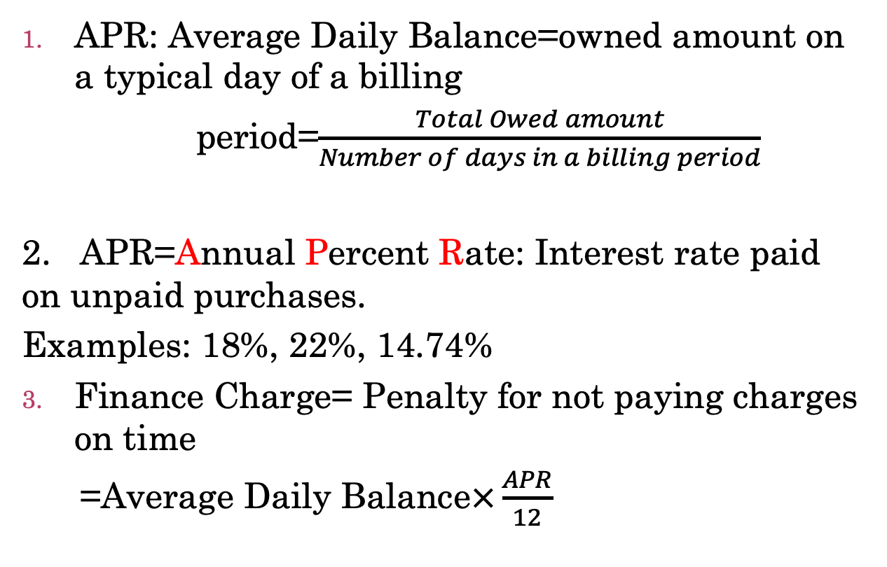
Formulas for Credit Card Calculations and Penalties
APR: Average Daily Balance=owned amount on a typical day of a billing
period=$\frac{Total Owed amount}{Number of days in a billing period}$
2. APR=Annual Percent Rate: Interest rate paid on unpaid purchases.
Examples: 18%, 22%, 14.74%
Finance Charge= Penalty for not paying charges on time
=Average Daily Balance$×\frac{APR}{12}$

Slide 4
Example 1
You have a credit card with an APR of 22%. You have paid off all but $1972 of your September balance. Your October billing period runs from October 8 through November 7. You then had the following activities on your credit card for the month of October:
You made a charge $530 on October 14
You made a payment of $1,000 on October 15
You made a charge $135.35 on October 21
You made a charge $102.62 on October 31
You made a payment of $800 on November 4
You made a charge $144 on November 5

Slide 5
Solution to Example 1
We make a table summarizing the credit card’s activity for the month:
Date | Purchase/pay | Balance | NO. of Days | Total
10/8-10/13 | $0 | $1972 | 6 | =$1972*6=$11,832
10/14-10/15 | +$530 | $2,502 | 2 | =$2502*2=$5004
10/16-10/20 | -$1000 | $1502 | 5 | =$1502*5=$7510
10/21-10/30 | +$135.35 | $1637.35 | 10 | =$1637.35*10 =$16373.5
10/31-11/3 | +$102.62 | $1739.97 | 4 | =$1739.97*4 =$6939.88
11/4 | -$800 | $939.97 | 1 | =$939.97*1=$939.97
11/5-11/7 | +$144 | $1083.97 | 3 | =$1083.97*3 =$3251.91
Total |  |  | 31 | $51,851.26

Slide 6
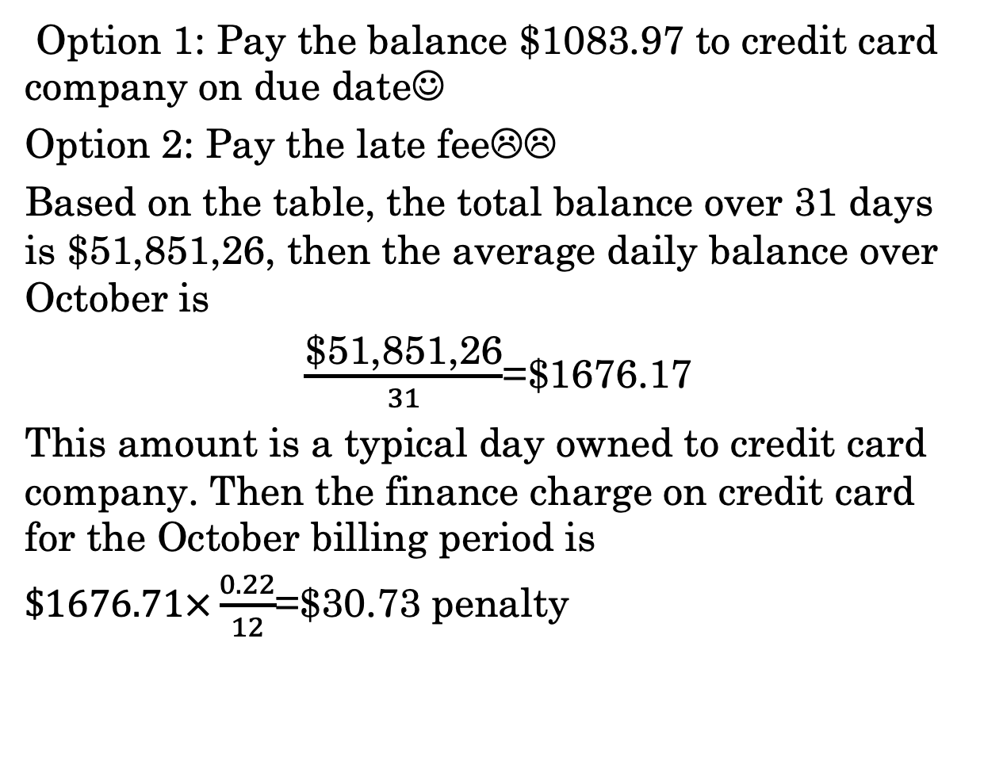
Example 1 Continued
Option 1: Pay the balance $1083.97 to credit card company on due date☺
Option 2: Pay the late fee☹☹
Based on the table, the total balance over 31 days is $51,851,26, then the average daily balance over October is
$\frac{\text{\$51,851,26}}{31}$=$1676.17
This amount is a typical day owned to credit card company. Then the finance charge on credit card for the October billing period is
$\$1676.71×\frac{0.22}{12}$=$30.73 penalty

Slide 7
Example 2
Bob has a credit card with an APR of 25%. He paid off all but $434 in May. Bob’s billing period runs from June 2 through July 1. He then:
made a charge $345 on June 3
made a charge $562.30 on June 10
made a charge $54.32 on June 15
made a payment of $100 on June 20
made a charge $562.35 on June 29

Slide 8
Solution to Example 2
We make a table summarizing the credit card’s activity for the month:
Date | Purchase/pay | Balance | NO. of Days | Total
6/2 | $0 | $434 | 1 | =$434*1=$434
6/3-6/9 | +$345 | $779 | 7 | =$779*7=$5453
6/10-6/14 | +$562.30 | $1341.30 | 5 | =$1341.30*5 =$6706.50
6/15-6/19 | +$54.32 | $1395.62 | 5 | =$1395.62*5 =$6978.1
6/20-6/28 | -$100.00 | $1295.62 | 9 | =$1295.62*9 =$11660.58
6/29-7/1 | +$562.35 | $1857.97 | 3 | =$1857.97*3 =$5573.91
Total |  |  | 30 | $36,806.09

Slide 9
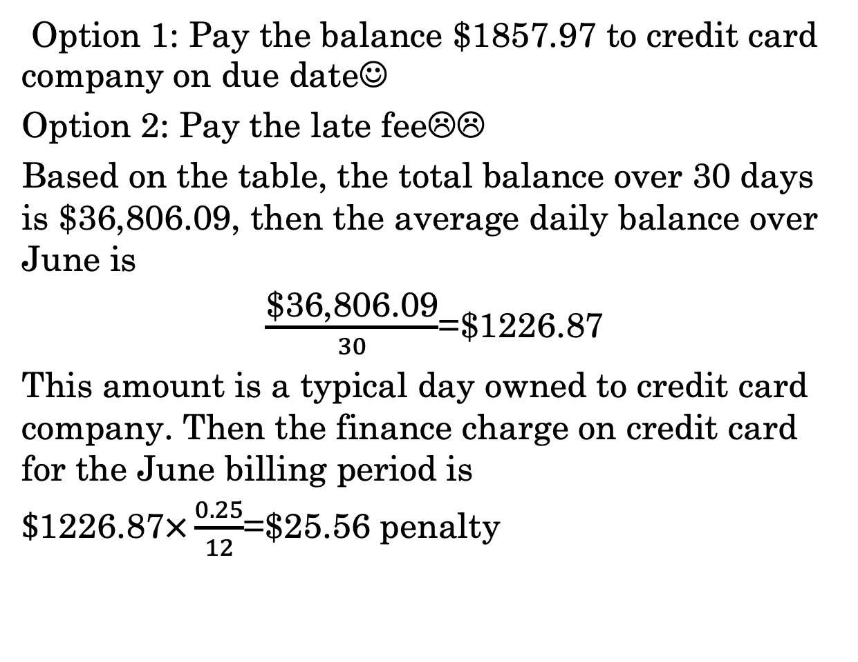
Example 1 Continued
Option 1: Pay the balance $1857.97 to credit card company on due date☺
Option 2: Pay the late fee☹☹
Based on the table, the total balance over 30 days is $36,806.09, then the average daily balance over June is
$\frac{\text{\$}\text{36,806.09}}{30}$=$1226.87
This amount is a typical day owned to credit card company. Then the finance charge on credit card for the June billing period is
$\$\text{1226.87}×\frac{0.25}{12}$=$25.56 penalty

